Slide 1

Leaf Development
Software Architecture
Styles: Service Oriented
and…
Maria Cortes - V&V Lead
Manuel Dosal – Systems Designer
Mario Flores - Lead Programmer 1
Rebekah Gruver – Programmer 2
Hector Quintana – Systems Architect
Marcela Vazquez - Systems Analyst

Slide 2
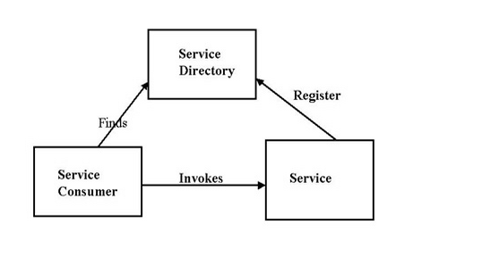
Service Oriented
What is it?
Service-oriented architecture is a client/server design approach in which an application consists of a collection of software services and software service consumers [1].
These services communicate with each other: Two roles a service provider and a service consumer.

Slide 3
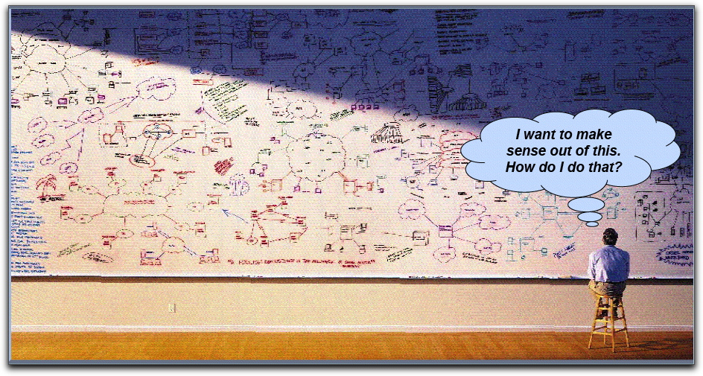
Service Oriented
Problems Addressed by a Service Oriented Architecture

Slide 4
Service Oriented
Elements
Application frontend
Active elements of the architecture, delivering the value to the end users. It initiates and control all activity of the enterprise system. Web application, application with GUI, or a batch application.
Service
A software component that encapsulates a high level business concept.
Service repository
It registers the services and their attributes to facilitate the discovery of services; operation, access rights, owner, or qualities.
Service Bus
A flexible infrastructure for integrating applications and services by : routing messages, transforming protocols between requestor and service, handling business events and delivering them. It provides mediation and security.
Contract
Provides a specification of the purpose, functionality, constraints, and usage of services.
Implementation
The service implementation provides the required business logic and appropriate data. It contains one or more of the artifacts: programs, configuration, data and databases.
Interface
Functionality exposed by the service to the clients that are connected to it.
Business logic
Business process represented by the service.
Data
Data represented in the service and used by it.

Slide 5
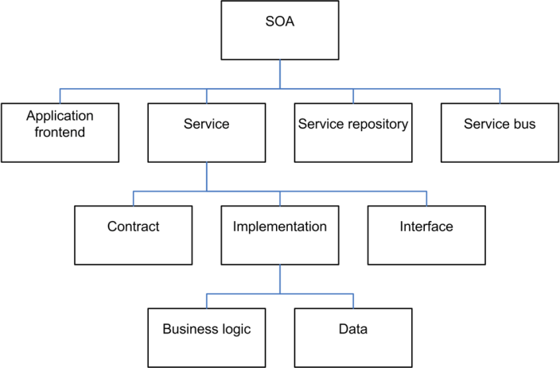
Service Oriented
Elements

Slide 6
Service Oriented
Strengths
Modularity
Reusability
Extendibility
Parallelism
Weaknesses
Development overhead
Latency
Dependency

Slide 7
Examples
Service Oriented
VisKo
VisKo uses transformation services to visualize data. Each service is independent and can services can be added or deleted.
Web Services
Each protocol was designed with the Service Oriented Architecture style in mind.

Slide 8
References
Resources
[1] http://www.indiawebdevelopers.com/resource_center/articles/soa.html
[2] http://en.wikipedia.org/wiki/Service-oriented_architecture

Slide 9

Questions?
Notes:
Security
The system shall require a user password of at least eight characters.
The user password shall include at least one capital letter.
The user password shall include at least one special character.
Maintainability
The system shall be accessible for the update and addition of Internet browsers.
The average person-time required to update or add Internet browsers (including regression testing and documentation update) shall not exceed 80 hours.

